Slide 1


Slide 2
Shaping the Future of Nursing Innovation: Our Story

Slide 3

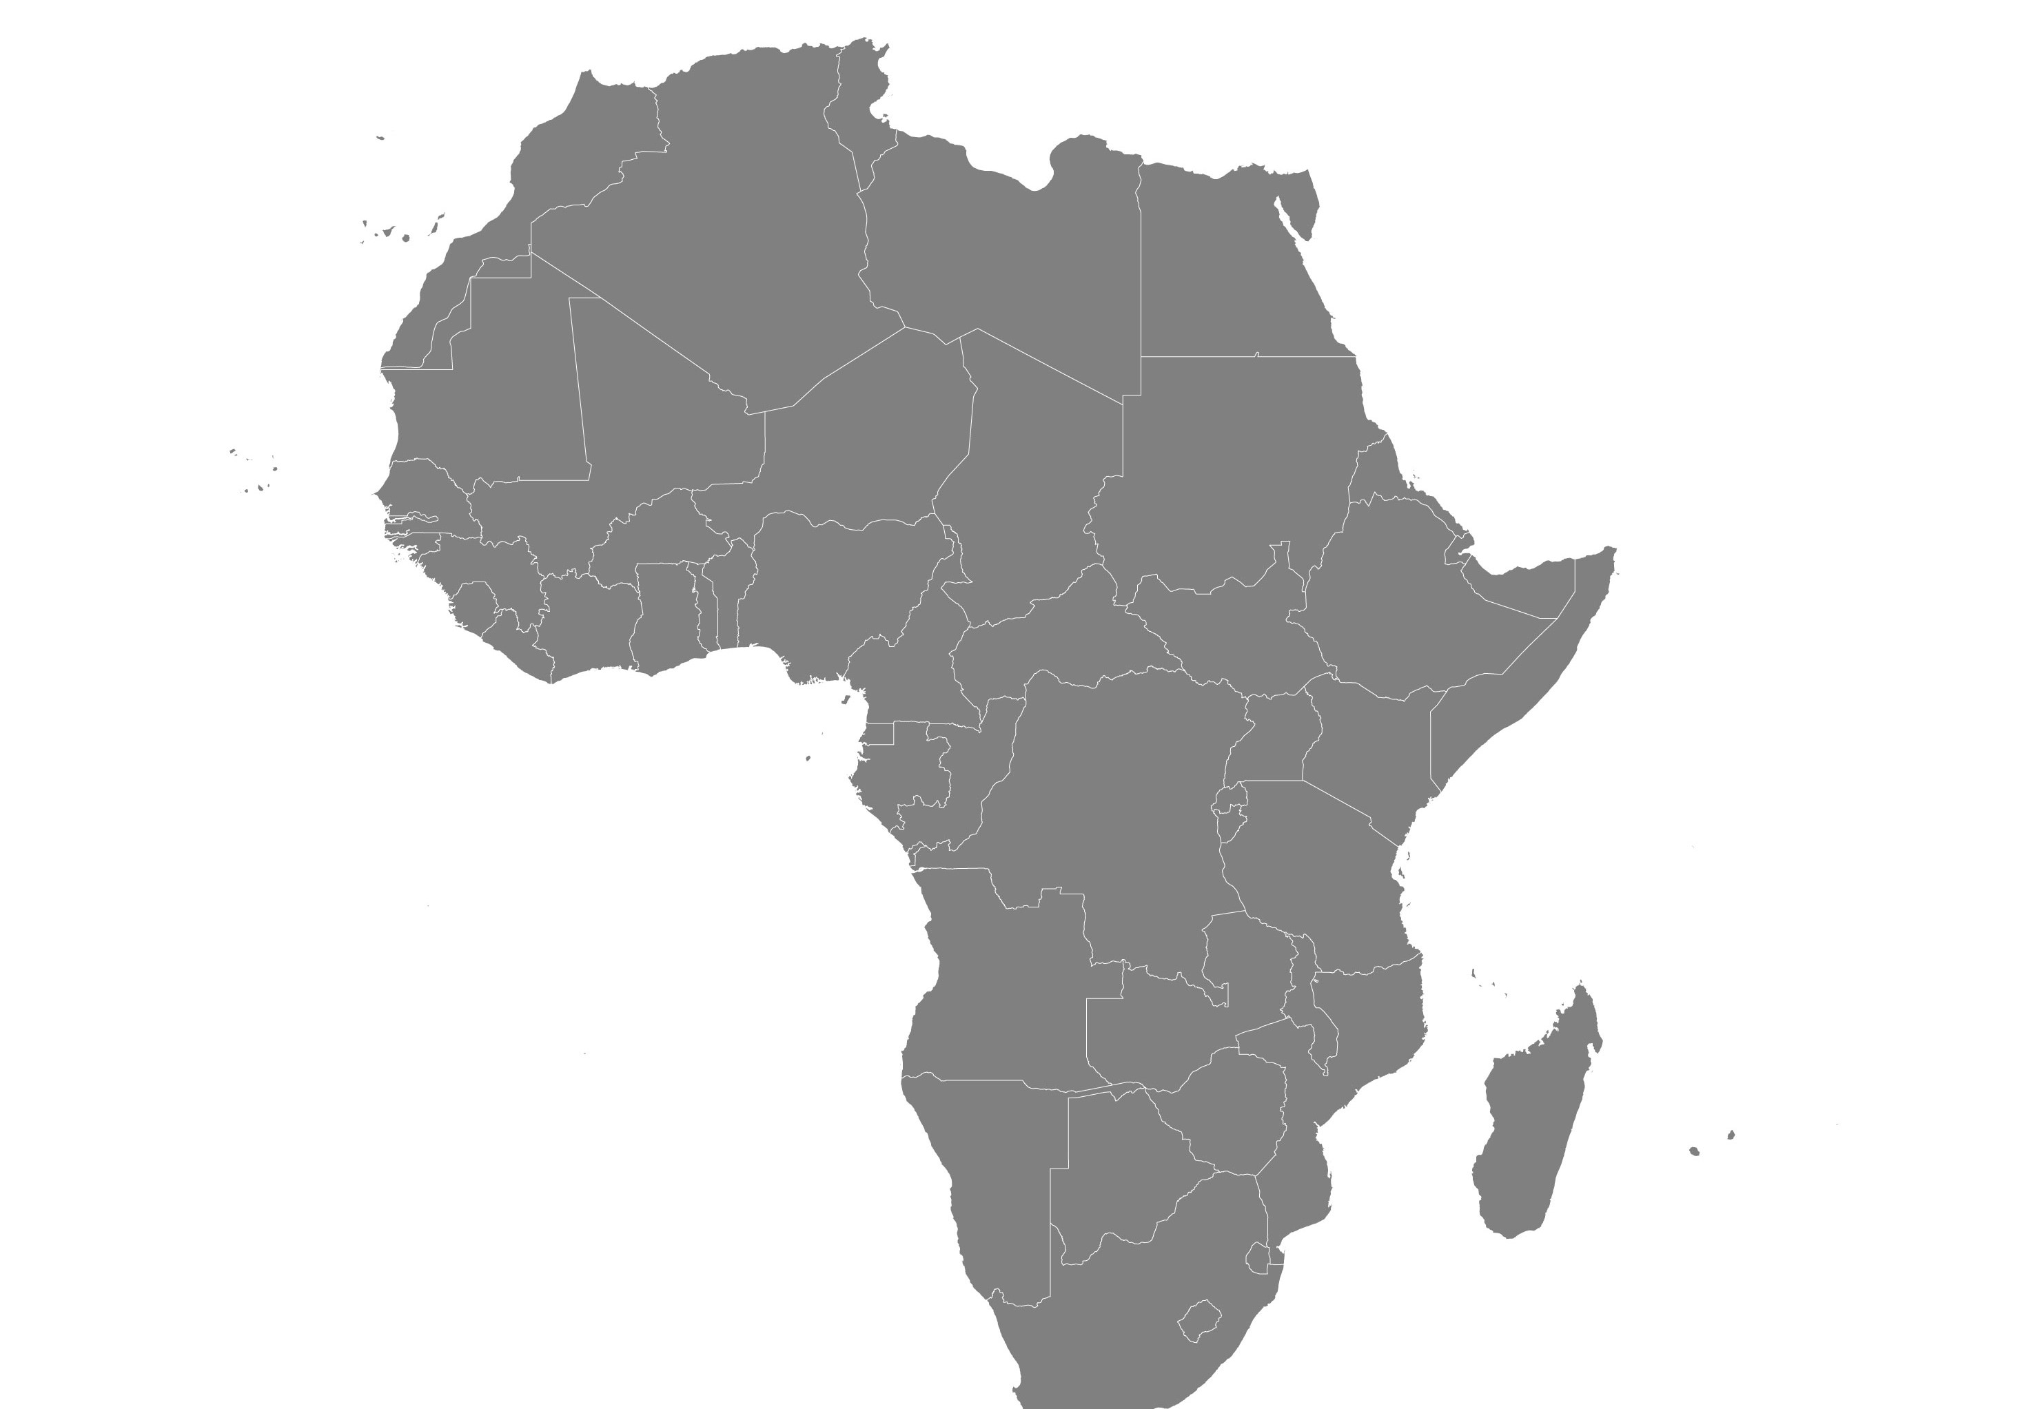
Nursing Innovation: What Is the Future for Africa?
THE PROBLEM:
Nursing Innovation gradually taking a part of the world by storm.
It appears an integral piece of the picture is missing.
Nursing Innovation is gradually blowing up a part of the world.
How can we light up the future of Africa with the gospel of Nursing Innovation?
How can today's seasoned innovators prepare for a world and future that doesn't yet exist?

Slide 4
Problem Articulation-
We are addressing the problem of a bleak future for nursing innovation in Africa as a result of inadequate investment in emerging Nurse innovators as well as lack of access to established mentors in the field of nursing Innovation.

Slide 5
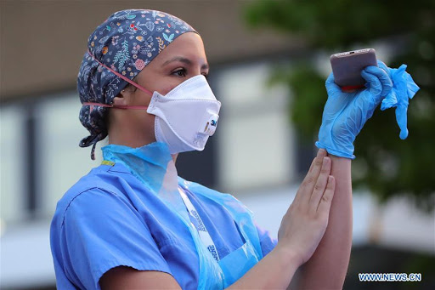
Dire Need..
Teach nursing Innovation, Nursepreneurship and global healthcare leadership in africa,
Raise hundreds of nurse innovators to secure the future of nursing innovation in Africa .
Invest in Africa's brightest minds who can provide nursing innovation and healthcare solutions that can address healthcare delivery challenges.

Slide 6

Our Solution
We need to develop a Nursing innovation in form of a DIGITAL APP + other web- based tools that can;
Eliminate geographical boundaries and limitations
connect Africa's brightest nurse innovators, with globally established healthcare leaders and innovators
Evolve the first ever African Digital Academy that will empower the next generation of nursepreneurs, innovators and healthcare leaders through structured E-Mentoring and coaching opportunities.

Slide 7


Scope and Market Opportunity
An existing network of 15,000 aspiring and emerging African nurses innovators.
A huge resource for addressing healthcare delivery challenges in Africa through nursing innovations.
Opportunity for shaping the future of nursing innovation for Africa
Early and mid careers nurses in Africa.
Older generation of nurses.
Students interested in advancing a career in nursing innovation.

Slide 8
Competition?
No competitor

Slide 9
Universities and Digital organization teaching Innovation as potential collaborators.
Collaboration
Collaborate with globally renowned and established Nurse innovators and
Healthcare innovation organizations.

Slide 10
Team Members
JOSIAH JACKSON-OKESOLA
LILLY-WEST BULOALA
ODEY ALICE
SUNDAY DANIEL OBEMBE
OJEDOKUN OLUWAGBEMISOLA
JOSEPHINE AMOAH

Slide 11
“I am a Nurse , I am also an Innovator and an Entrepreneur.” - Rebecca Love

